Slide 1


Consumer Protection Working Party Meeting
Sponsor

Slide 2
Solvency II and consumer protection
AIDA Working Party (WP) on Consumer Protection and Dispute Resolution
11/06/2015

Slide 3




EU Regulatory Outlook
Coherence of legislation
Recovery & Resolution for FMIs
Shadow Banking
Regulation on Structural Reform
NBNI G-SIFI
ELTIF
Solvency II
Bank
Recovery & Resolution Directive
Additional Derivatives Regulations
Living Wills
MMFs
Dodd-Frank Act
Investor Compensation schemes
Volcker Rule
MiFID II / MiFIR
SFT Transparency
EuVECA
FATCA
Mortgage Directive
Banking Union
UCITS V
NSFR
EuSEF
CSD Regulation
Insurance
Guarantee
Scheme
Basel III
CRD IV / CRR
Leverage Ratio
PRIIPs
FTT
& our customers
UCITS VI
AIFMD
Deposit Guarantee Schemes
Transparency Directive
Fundamental Review of the Trading Book
Corporate
Governance
IMD 2
Credit Rating Agencies Regulation
Prospectus Directive
Capital
Markets Union
IORP II
Data Protection
EMIR
MAD
MAR
Short Selling
Benchmarks Regulation
Margin Derivatives for OTC
SEPA End-date
Long-term Financing
Payments Package
(PSD II)
Remuneration
4th AML Directive
Shareholders Right Directive
“EU FATCA”
Bank Account
Legal Entity Identifier
Securities Law Regulation

Slide 4
Solvency 2 - a recast of existing directives
Reasons for revision
The Solvency II revision process aims to:
take account of current developments in insurance, risk management, finance techniques, international financial reporting and prudential standards, etc.
streamline the way that insurance groups are supervised and recognises the economic reality of how groups operate.
strengthen the powers of the group supervisor, ensuring that group-wide risks are not overlooked
ensure greater cooperation between supervisors. Groups will be able to use group-wide models and take advantage of group diversification benefits.
Results
The new system will lay down
  quantitative requirements and how to calculate them
  qualitative requirements (risk management and supervision)
  requirements for supervisory reporting and disclosure of information.

Slide 5
Solvency 2 and consumer protection
S2 protects consumers by protecting capital.
S2 does not provide specific regulation on how to treat customers fairly
S2 does not directly adress information imparity between consumer and product provider
S2 does not adress conduct and conflicts of interests when selling
But EIOPA is aiming to fill the gap …based on Article 16 of Regulation (EU) No1094/2010 of the European Parliament and of the Council of 24 November 2010 establishing a European Supervisory Authority
Further consumer protection provided by PRIIPs (products) and IMD2 (distribution)

Slide 6
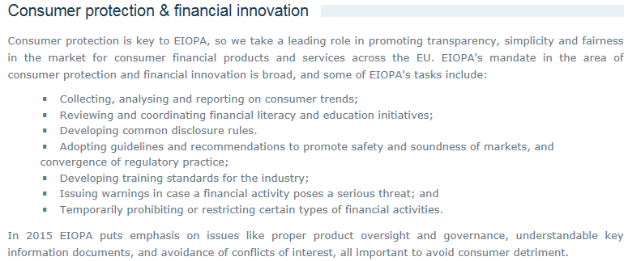
EIOPAs intention
EIOPA website:

Slide 7
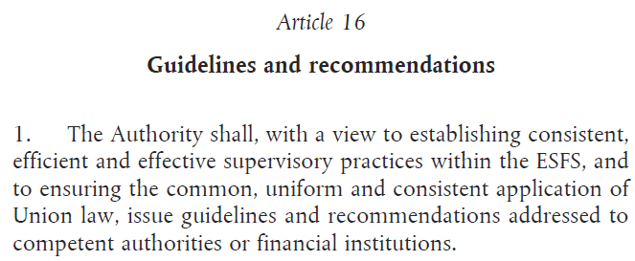

Art. 16 – a mandate to regulate
Commission vs. UK on short-selling suggest a very broad mandate

Slide 8
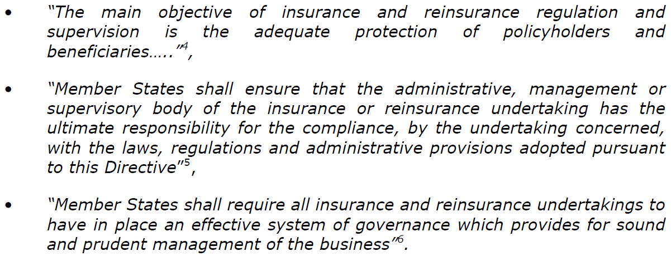
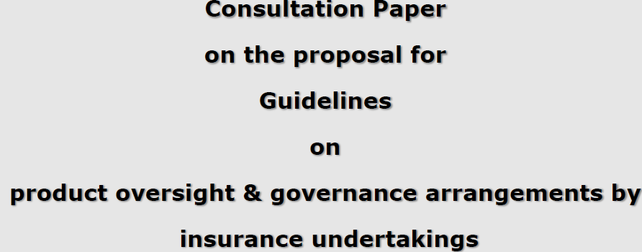
Product oversight under Solvency2 - EIOPA
The preamble of S2:
combined with Art. 16 =>
12 guidelines

Slide 9
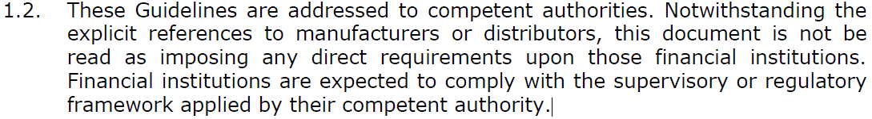
The proposed 12 guidelines
The manufacturer should:
  Establishment of product governance and oversight arrangements
  Role of the manufacturer’s administrative, management or supervisory body
  Review of product governance and oversight arrangements
  Management of conflicts of interest in product design
  Target market
  Knowledge and ability of staff involved in the design of products
  Product testing
  Product monitoring
  Remedial action
  Distribution channels
  Outsourcing of the product design
  Documentation of product governance and oversight arrangements

Slide 10
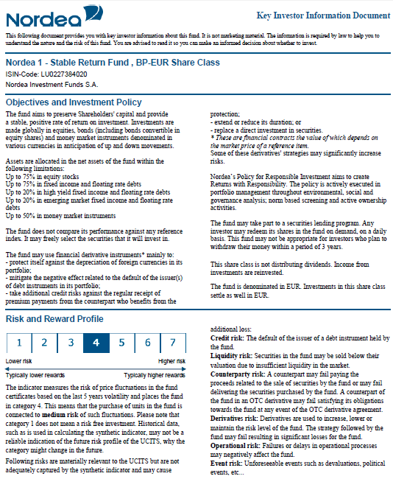
PRIIPs - Key information document – from 31/12 2016
Consultation by ESAs ended on February 15th 2015
Consultative Expert Group established
Mandatory 3 page A4 document
Must be provided to consumers before any commitment is made
Should adress all complex products
Should be engaging for retail investors and help them comprehend and compare products
Will contain summary risk indicator, performance scenarios, and cost disclosures
-and product intervention powers for EIOPA

Slide 11
Similar rules for similar products ?

Slide 12
IMD2 progressing slowly
Intention to avoid regulatory arbitrage stated in preambles of both MiFID2, Solvency2 and IMD2
Trilogues will continue under Luxembourg presidency in the fall.
IMD2 negotiations on:
  Bonuses?
  Commission ban?
  Training requirements?
  Ban on tying?
  Sanctions

Slide 13
Thank you !

